Slide 1


Working with Textual Data

Slide 2
ML Model
Text Data
Math works with numbers

Slide 3
ML Model
Text Data
Convert Text to Numbers

Slide 4

How to convert text into Numbers

Slide 5
Document #1
Document #2
He is a good boy. She is also good.
Radhika is a good person.
Vocabulary
a, also, boy, good, He, is, person, She, Radhika

Slide 6
Document #1
Document #2
He is a good boy. She is also good.
Radhika is a good person.
Vocabulary
a, also, boy, good, He, is, person, She, Radhika
 | a | also | boy | good | He | Is | person | She | Radhika
Index | 0 | 1 | 2 | 3 | 4 | 5 | 6 | 7 | 8
Assign index for each word in Vocabulary

Slide 7
Document #1
Document #2
He is a good boy. She is also good.
Radhika is a good person.
Vocabulary
a, also, boy, good, He, is, person, She, Radhika
 | a | also | boy | good | He | Is | person | She | Radhika
Index | 0 | 1 | 2 | 3 | 4 | 5 | 6 | 7 | 8
Document# 1
Count how many times each word in Vocabulary appears in Document #1

Slide 8
Document #1
Document #2
He is a good boy. She is also good.
Radhika is a good person.
Vocabulary
a, also, boy, good, He, is, person, She, Radhika
 | a | also | boy | good | He | Is | person | She | Radhika
Index | 0 | 1 | 2 | 3 | 4 | 5 | 6 | 7 | 8
Document #1 | 1 | 1 | 1 | 2 | 1 | 2 | 0 | 1 | 0
Document #1 = [1, 1, 1, 2, 1, 2, 0, 1, 0]

Slide 9
Document #1
Document #2
He is a good boy. She is also good.
Radhika is a good person.
Vocabulary
a, also, boy, good, He, is, person, She, Radhika
 | a | also | boy | good | He | Is | person | She | Radhika
Index | 0 | 1 | 2 | 3 | 4 | 5 | 6 | 7 | 8
Document #1 | 1 | 1 | 1 | 2 | 1 | 2 | 0 | 1 | 0
Document #2 | 1 | 0 | 0 | 1 | 0 | 1 | 1 | 0 | 1
Document #2 = [1, 0, 0, 1, 0, 1, 1, 0, 1]

Slide 10
Document #1
Document #2
He is a good boy. She is also good.
Radhika is a good person.
Vocabulary
a, also, boy, good, He, is, person, She, Radhika
 | a | also | boy | good | He | Is | person | She | Radhika
Index | 0 | 1 | 2 | 3 | 4 | 5 | 6 | 7 | 8
Document #1 | 1 | 1 | 1 | 2 | 1 | 2 | 0 | 1 | 0
Document #2 | 1 | 0 | 0 | 1 | 0 | 1 | 1 | 0 | 1
Count Vector

Slide 11
TF-IDF Vector
Not just simple counting

Slide 12

Document #1
He is a good boy. She is also good.
He | 1
is | 2
a | 1
good | 2
boy | 1
she | 1
also | 1
Total | 9
TF(He, doc#1) = 1/9 = 0.11
TF(good, doc#1) = 2/9 = 0.22

Slide 13
Document #2
Radhika is a good person.
Radhika | 1
is | 1
a | 1
good | 1
person | 1
Total | 5
TF(He, doc#2) = 0/5 = 0
TF(good, doc#2) = 1/5 = 0.2

Slide 14

Document #1
Document #2
He is a good boy. She is also good.
Radhika is a good person.
He | 1
is | 2
a | 1
good | 2
boy | 1
she | 1
also | 1
Total | 9
Radhika | 1
is | 1
a | 1
good | 1
person | 1
Total | 5
IDF(He) = log(2/1) = 0.301
IDF(good) = log(2/2) = 0
TF-IDF(He, doc#1) = 0.11 * 0.301 = 0.03311
TF-IDF(good, doc#1) = 0.22 * 0 = 0
TF-IDF(He, doc#2) = 0 * 0.301 = 0
TF-IDF(good, doc#2) = 0.2 * 0 = 0

Slide 15
Document #1
Document #2
He is a good boy. She is also good.
Radhika is a good person.
Vocabulary
a, also, boy, good, He, is, person, She, Radhika
 | a | also | boy | good | He | Is | person | She | Radhika
Index | 0 | 1 | 2 | 3 | 4 | 5 | 6 | 7 | 8
Document #1 |  |  |  | 0 | 0.03311
Document #2 |  |  |  | 0 | 0
TF-IDF Vector

Slide 16
Keras Tokenizer Class

Slide 17
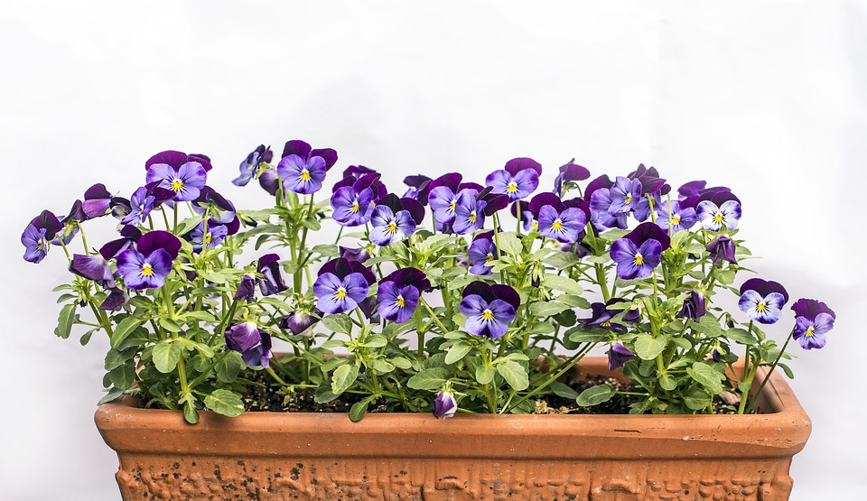
Exercise: Sentiment Analysis

